Slide 1
Random Forest
Divya Agarwal

Slide 2
Table of Contents
Introduction
Decision Trees Overview
How it works
Example
Feature importance
Deference between Decision Trees and Random Forests
Conclusion

Slide 3
Introduction
Random forest algorithm can use both for classification and the regression kind of problems.
Random forest algorithm is a supervised classification algorithm.
As the name suggest, this algorithm creates the forest with a number of trees.
What is a Decision Tree ?

Slide 4
Decision Trees
Supervised Learning Algorithm, used for solving classification and regression problems.
The general motive of using Decision Tree is to create a training model which can use to predict class or value of target variables by learning decision rules inferred from prior data(training data).

Slide 5
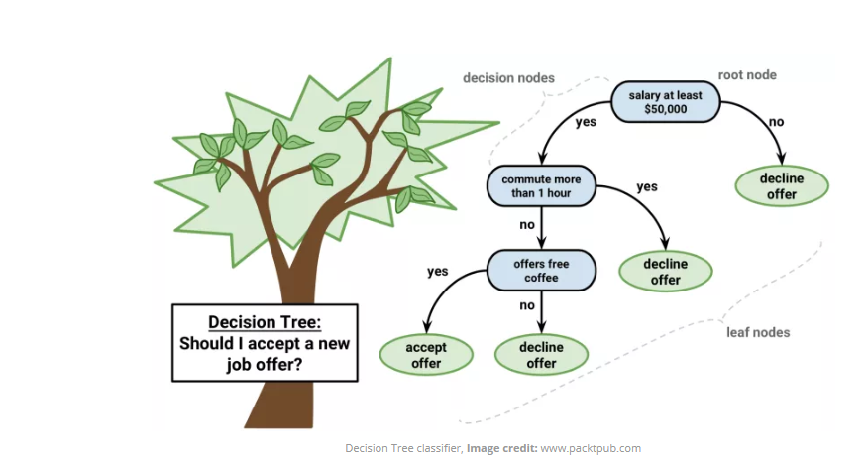
Decision Tree Algorithm
Notes:
1. Place the best attribute of the dataset at the root of the tree.
2. Split the training set into subsets. Subsets should be made in such a way that each subset contains data with the same value for an attribute.
3. Repeat step 1 and step 2 on each subset until you find leaf nodes in all the branches of the tree.
Each internal node of the tree corresponds to a feature, and each leaf node corresponds to a class label.

Slide 6
Attributes Selection
The popular attribute selection measures:
1. Information gain
2. Gini index
Notes:
The primary challenge in the decision tree implementation is to identify which attributes do we need to consider as the root node and each level. Handling this is know the attributes selection. We have different attributes selection measure to identify the attribute which can be considered as the root note at each level.
By just randomly selecting any node to be the root can’t solve the issue. If we follow a random approach, it may give us bad results with low accuracy.

Slide 7


Information gain
Entropy : for a discrete random variable X with N outcomes :-
Information gain tells us how important a given attribute of the feature vectors is.
Notes:
Entropy is the measure of randomness or impurity
Formula of Entropy explained :- Pi is the fraction of examples in class I and We are summing over all the classes
Two intuitions :-
If all the examples are of the same class; entropy = 0
If all the samples are evenly split between the classes, then; entropy = 1
Additional Examples -
https://stackoverflow.com/questions/1859554/what-is-entropy-and-information-gain
Information Gain
1. We want to determine which attribute in a given set of training feature vectors is most useful for discriminating between the classes to be learned.
2. We will use it to decide the ordering of attributes in the nodes of a decision tree.

Slide 8

Gini Index
Gini Index is a metric to measure how often a randomly chosen element would be incorrectly identified. It means an attribute with lower gini index should be preferred.

Slide 9
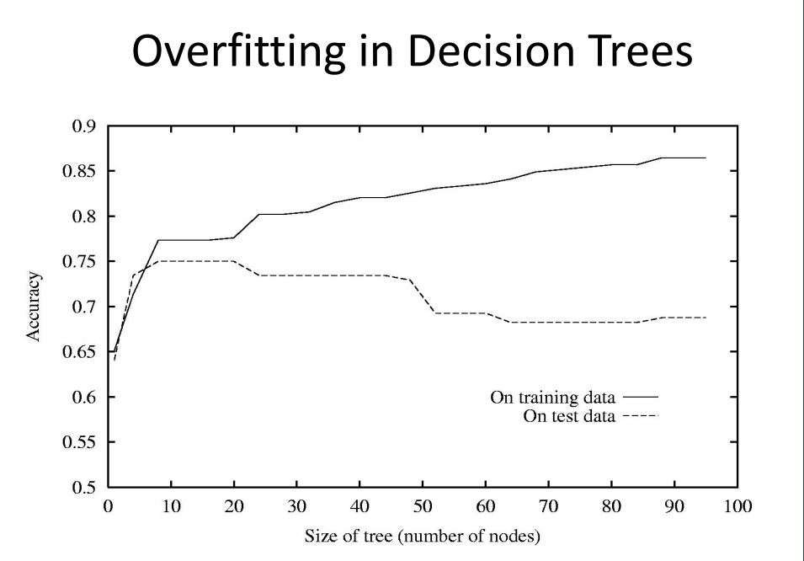
Overfitting in Decision Trees
Decision trees perfectly partitions the training set, thus leading to overfitting.
Notes:
If you tell a kid that the tree has green leaves, when he sees a tree with yellow/orange leaves it does not know whether it is a tree or not.
Generalize over training data

Slide 10
Program Demo
Lets look at the Jupyter Notebook!

Slide 11
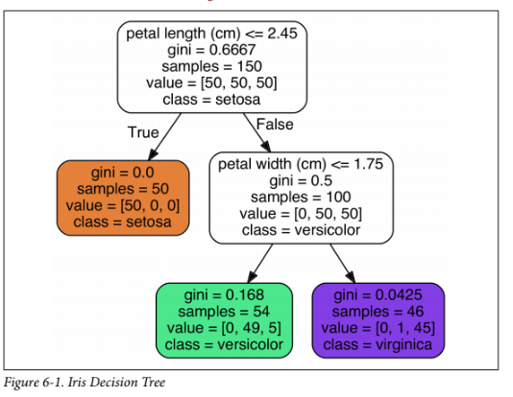
Iris dataset Tree

Slide 12
Ensemble Learning
if you aggregate the predictions of a group of predictors (such as classifiers or regressors), you will often get better predictions than with the best individual predictor.
A group of pre‐ dictors is called an ensemble; thus, this technique is called Ensemble Learning
Ensemble Learning algorithm is called an Ensemble method.
The most popular Ensemble methods, including bagging, boosting, stacking, and a few others

Slide 13
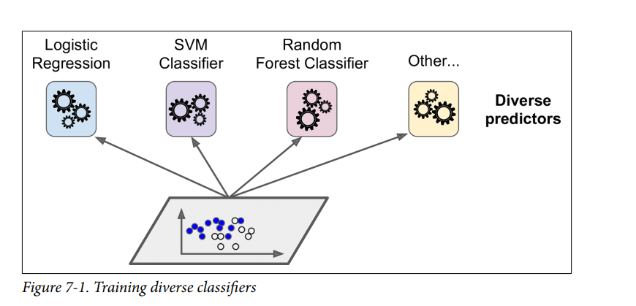
Notes:
if you aggregate the predictions of a group of predictors (such as classifiers or regressors), you will often get better predictions than with the best individual predictor.
A group of pre‐ dictors is called an ensemble; thus, this technique is called Ensemble Learning
Ensemble Learning algorithm is called an Ensemble method.
The most popular Ensemble methods, including bagging, boosting, stacking, and a few others

Slide 14
Bagging
One way to get a diverse set of classifiers is to use very different training algorithms, as just discussed.
Another approach is to use the same training algorithm for every predictor, but to train them on different random subsets of the training set.
When sampling is performed with replacement, this method is called bagging (bootstrap aggregating )

Slide 15
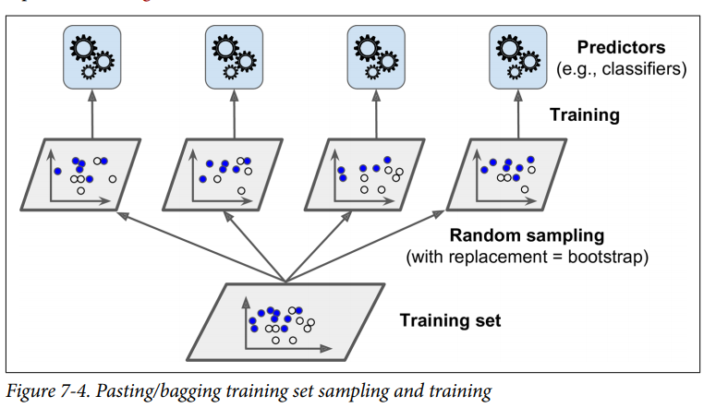
Notes:
One way to get a diverse set of classifiers is to use very different training algorithms, as just discussed.
Another approach is to use the same training algorithm for every predictor, but to train them on different random subsets of the training set.
When sampling is performed with replacement, this method is called bagging (bootstrap aggregating )

Slide 16
Back to Random Forest
Random forests or random decision forests are an ensemble learning method forclassification, regression and other tasks, that operate by constructing a multitude of decision trees at training time and outputting the class that is the mode of the classes (classification)

Slide 17
Feature Importance
Increasing the predictive power
n_estimators
max_features
min_sample_leaf
Increasing the model’s sped
n_jobs
random_state
Notes:
N_estimators = no of trees ; greater the number of trees better is the accuracy
Max_features = no of features to consider when looking for best split ; avoid overfitting
min_samples_split = The minimum number of samples required to split an internal node ; overfitting

Slide 18
Decision Tree vs Random Forest
You are right that the two concepts are similar. As is implied by the names "Tree" and "Forest," a Random Forest is essentially a collection of Decision Trees. A decision tree is built on an entire dataset, using all the features/variables of interest, whereas a random forest randomly selects observations/rows and specific features/variables to build multiple decision trees from and then averages the results. After a large number of trees are built using this method, each tree "votes" or chooses the class, and the class receiving the most votes by a simple majority is the "winner" or predicted class.

Slide 19
Conclusion
Random Forest Applications
Banking
Medicine
Stock Market
E-commerce
Advantages
No overfitting during classification
Feature engineering : identify most important features out of the available features from training dataset

Slide 20
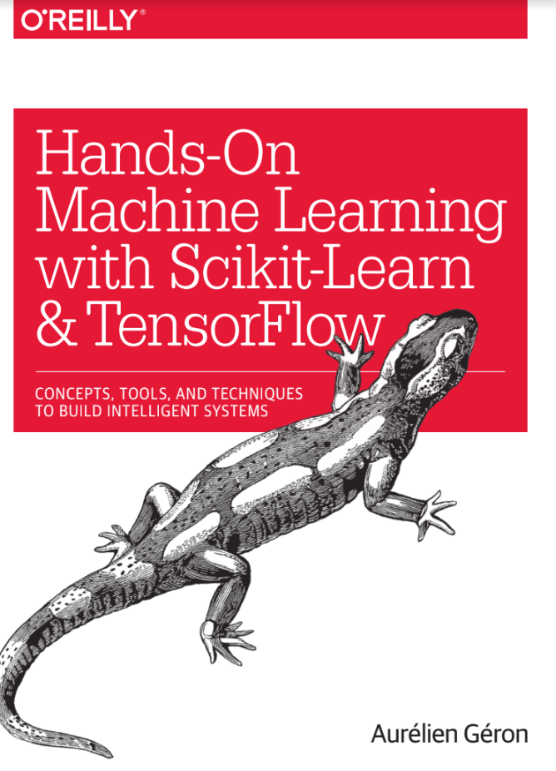
References!

Slide 21
Useful Links
https://machinelearningmastery.com/bagging-and-random-forest-ensemble-algorithms-for-machine-learning/
https://github.com/llSourcell/random_forests/blob/master/Random%20Forests%20.ipynb
https://dataaspirant.com/2017/01/30/how-decision-tree-algorithm-works/

